Slide 1
Lego Box Recognition
Sun, Lyu, Zhang, Chen
27 May 2016

Slide 2




Image Preprocessing
Standard form
Scaling change
Rotation
Perspective transform
We use image preprocessing to detect the red logo, recover the shooting box to standard form from any shooting angle and extract the area of the number.
Number area is the area under the logo in the image.
Standard form was defined as the box surface parallel with the shooting camera and the texts are normal morphology in the image.
Notes:
Ok, thanks Li sun, I will simply explain the what’s the image preprocessing in our works.
Each box have a unique number, we are trying to use it to classify the box.

Slide 3
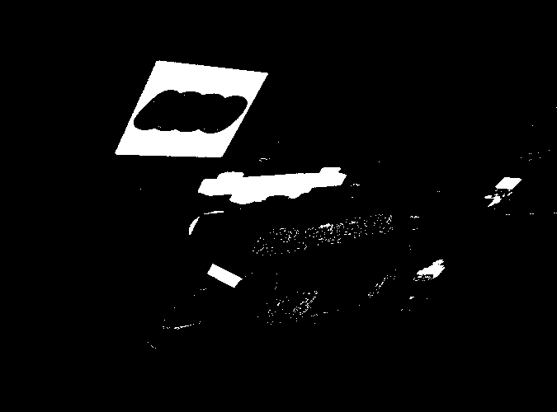
Image Preprocessing
Step1: Using HSV color space to find the red area in the image. The result is a mask.
Notes:
Ok ,I will show the image preprocessing workflow by a good sample. Remember it’s a good sample. Consists of 6 steps.
Because the logo is a red square. It will narrow down the search area.

Slide 4
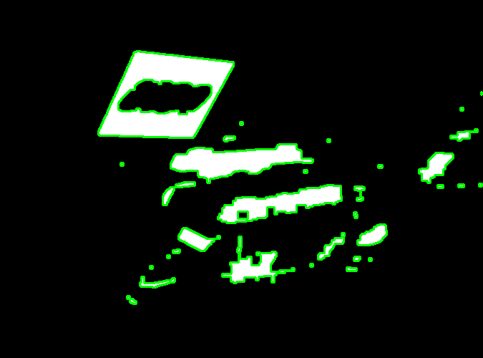
Image Preprocessing
Step 2: Finding all contours from the mask.
Notes:
Opencv provided a useful implementation, we just need to use it.

Slide 5
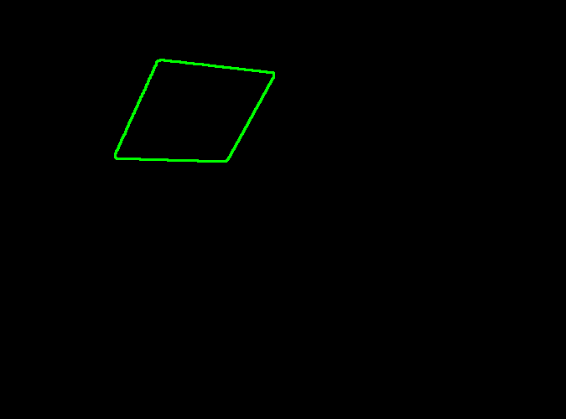
Image Preprocessing
Step 3: Picking the biggest quadrilateral from the contours by some geometric attribution.
Notes:
Using the image moments to calculate some geometric attribution(area, perimeter). I don’t really want to closely explain How to do that?

Slide 6
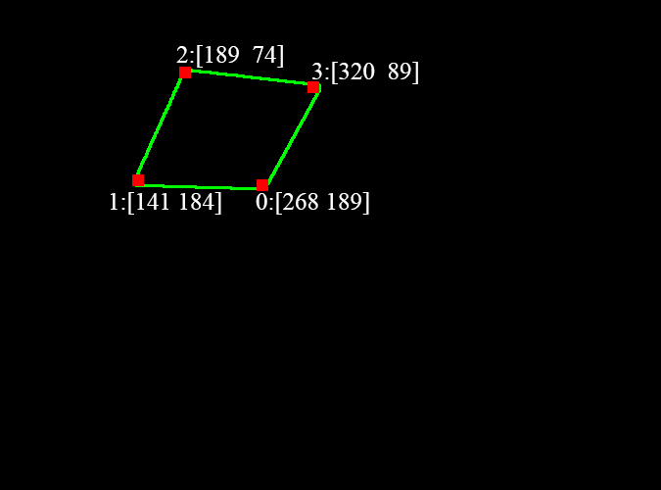
Image Preprocessing
Step 4: Detecting and sorting the four corners by Harris method. It could also verify the contour whether is a quadrilateral.
Notes:
Quadrilateral must have 4 corners, no more, no less. About sorting, we use some a small trick to make the points always be sorted clockwise.

Slide 7
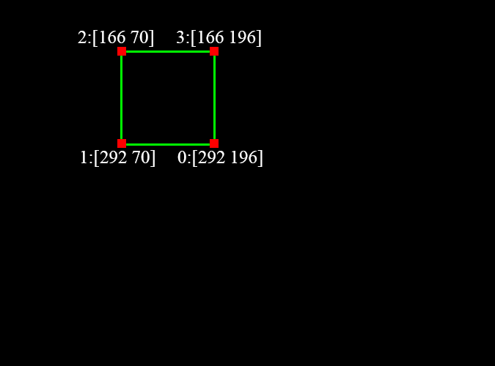
Image Preprocessing
Step 5: Creating a standard square preparing for affine transform.
Notes:
The length and location of this square determined by the quadrilateral we detected.

Slide 8

Image Preprocessing
Step 6: Calculating the transformation matrix(tM) by quadrilateral corners and standard square corners.
tM could be used to recover the tortile box.
Notes:
And we can get a good result now.

Slide 9

Image Preprocessing
Pick red area
Find contours
Pick quadrilateral contour
Find and sort 4 corners
Create standard square
Calculate tM & Recover image
Is that finish?
Notes:
Ok, let’s review key techniques. Is that finish? Of corse not, I said this is a good sample before. So if we have a bad sample, what will happen??

Slide 10
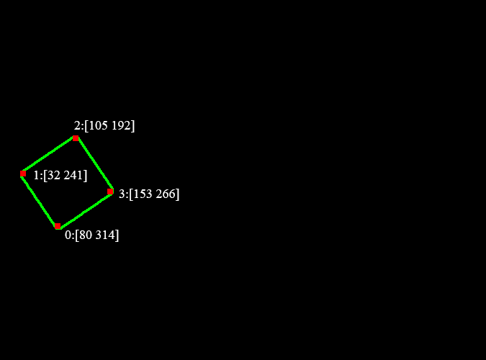
Image Preprocessing
Pick red area
Find contours
Pick quadrilateral contour
Find and sort 4 corners
Create standard square
Calculate tM & Recover image
Notes:
Now, In here, we choose the rotated box, The first 4 steps are same with the last image. But when we finding and sorting the 4 corners, did you see any difference?

Slide 11
Image Preprocessing
2
1
0
3
Pick red area
Find contours
Pick quadrilateral contour
Find and sort 4 corners
Create standard square
Calculate tM & Recover image
Notes:
Let’s mark these 4 points in the image.

Slide 12
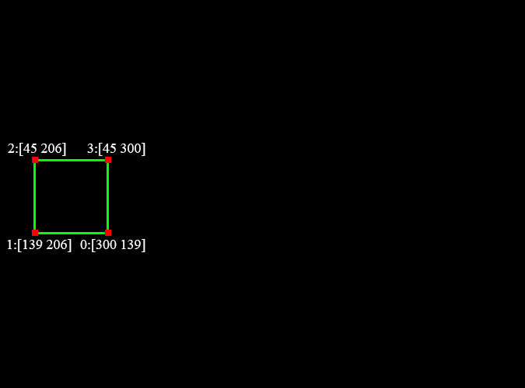
Image Preprocessing
2
1
0
3
Pick red area
Find contours
Pick quadrilateral contour
Find and sort 4 corners
Create standard square
Calculate tM & Recover image
Notes:
Next step, let’s create a square and mark the four corners of this square. What will happen if we use these eight corners to calculate the transformation matrix and recover the image?

Slide 13

Image Preprocessing
2
1
0
3
Pick red area
Find contours
Pick quadrilateral contour
Find and sort 4 corners
Create standard square
Calculate tM & Recover image
Notes:
We will get a orthogonal result comparing with the standard form. Why that happen? Because we just know corner points are clockwise sorting, we don’t know the absolutely correct corners position. Got it? But anyway, we have a orthogonal result now.

Slide 14

Image Preprocessing
Matching the feature points with the standard logo image
Estimating rotation angle by matched feature points
Rotation again
Notes:
How can we overcome this and get a correct result. We used feature points matching. We try to crop the vertical logo and matching the feature points with the standard logo image.

Slide 15
Image Preprocessing
Matching the feature points with the standard logo image
Estimating rotation angle by matched feature points
Rotation again
Notes:
Some people probably will ask, why don’t use the matching points to calculate the transformation matrix directly? Because the matching points are not always correct, many of these points are wrong matching. we can only use matching points to get a very roughly result It’s not accurate enough for transformation matrix. But if we add the previous result. we just need to judge these roughly result is 0, 90, 180, -90. Previous result is vertical or parallel with the correct result. So that’s why we do that.

Slide 16
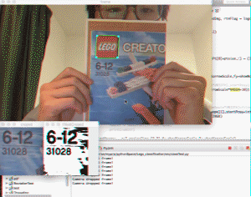

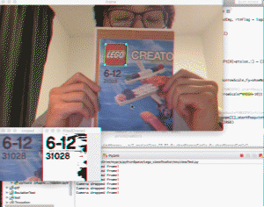
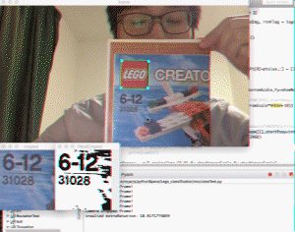
Image Preprocessing
Scaling
Rotation
Perspective
transform
Figx. Implementing result
Notes:
I will show a short video. You can see, This algorithm performed good. It could against the scaling rotation and perspective transform and recover the image to what we want. it does work

